Slide 1
AuctionBits
Syed Ishtiak Rahman
Saleh Akram Joy
Sharita Rahman
Rafi Hasan Zihad
Jisan Hasan

Slide 2
Five Usability Heuristics

Slide 3
VISIBILITY
Visibility states or show the information happend in our websites. It shows the status or update if something going on in our site.
Example: File uploading, downloading info, error show etc.

Slide 4
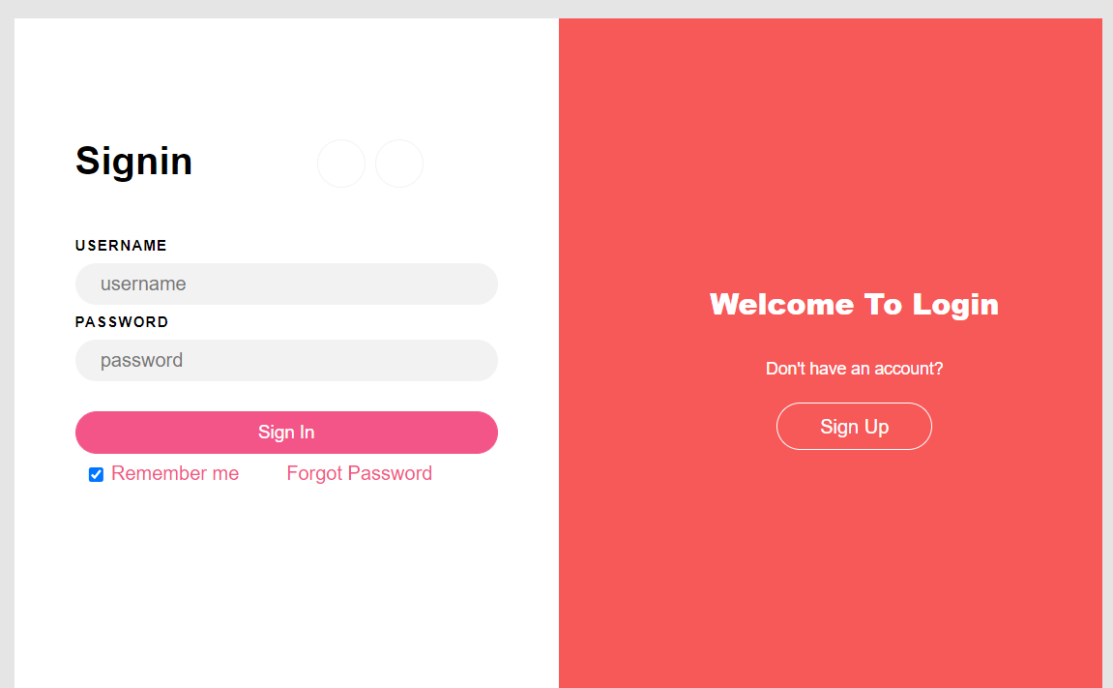
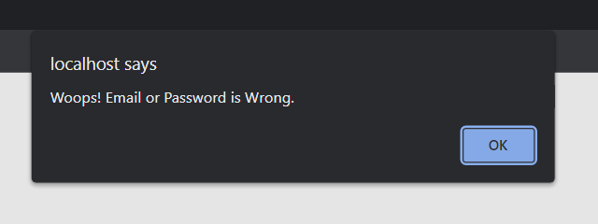

Slide 5
Mapping
System should use user familiar or user friendly interface. We are use to see same type of page in different website and our brain has mapped it.
Example: login signup page.

Slide 7
Flexibility
Any user can use the advance feature easily and we design our website easily so that any user shouldn’t face any difficulty.

Slide 8
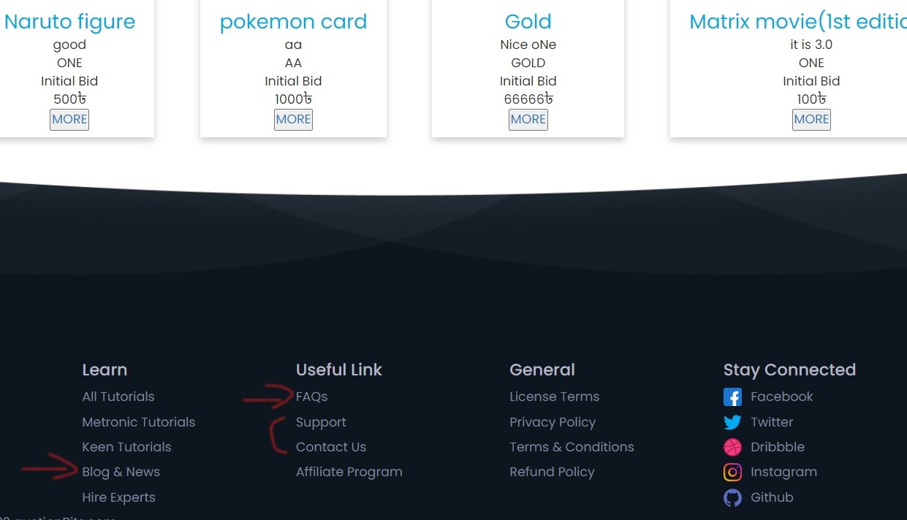

Slide 9
Consistency
Same language and interface throughout the whole website should be implemented. User shouldn’t face different interface in different pages of the website.

Slide 10
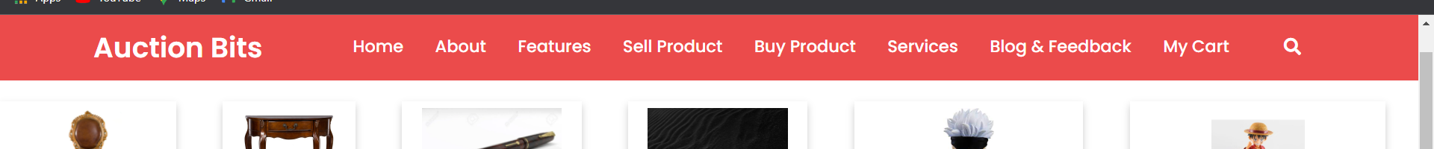
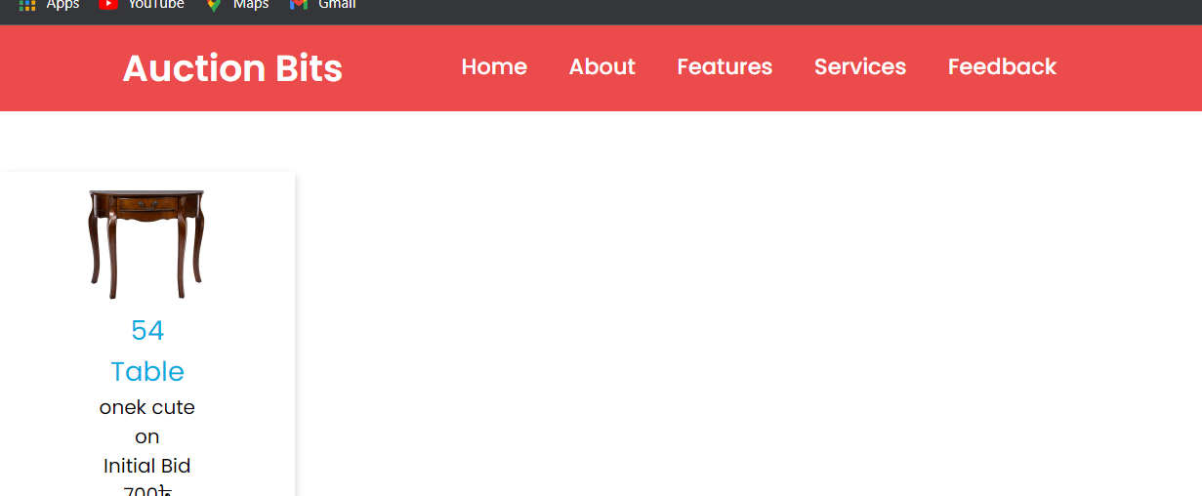
HOME PAGE
DESCRIPTION PAGE

Slide 11
Recognition
Instructions for use of the system should be visible or easily retrievable whenever appropriate.
Example: Bad UI/UX design

Slide 12
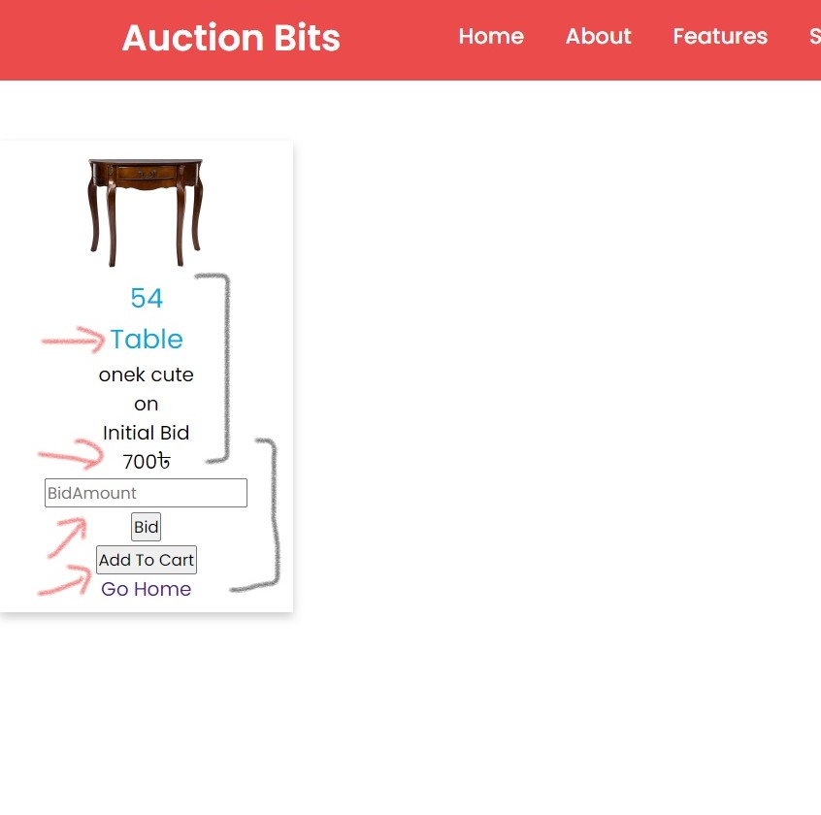
Recognition

Slide 13
THANK YOU

